Slide 1



Marketplace Builder
Hackathon Day2
Planning
The Technical Foundation
Presented by
Areesha Kainat

Slide 2


Day 2 Activities:
Transitioning to Technical Planning
Technical Requirements
System Architecture
API Requirements
Technical Documentation
Collaborateand Refine
Next Slide

Slide 3
Technical
Requirement :
1.Frontend:
Next.js & Tailwind CSS: Responsive, modern design for all devices.
Key Pages: Home, Categories, Car Details, Dashboard, Payment, Cart, Checkout, Order Confirmation.
Quick Booking: Easy search filters by location, date, and car type.
2..Backend (Sanity CMS):
Schema Design: Manage car details, customer info, and orders.
Real Time Updates: Dynamic pricing and availability.
3.Third-Party APIs:
Stripe Payments: Safe and smooth payments in multiple currencies.
Shipment Tracking: Real-time updates for car delivery/pickup.
Next Slide

Slide 4
2.Design
System Architecture:
Software Architecture:
[Frontend (Next.js & Tailwind CSS)]
| | |
| | |
[Sanity CMS] [Stripe API] [Shipment Tracking API]
| | |
| | |
[Product Data API] [Order Management API]
Next Slide

Slide 5
User Visits Frontend
|
User Browses Cars
|
Fetch Car Data from Sanity CMS
|
Display Cars on Frontend
|
User Selects Car and Adds to Cart
|
User Proceeds to Checkout
|
Save Order in Sanity CMS
|
Process Payment via Stripe API
|
Payment Successful? --> Yes --> Fetch Tracking Data
| |
No
| Display Order Confirmation
| |
Display Payment Error
Flowchart:
Next Slide

Slide 6
Product Browsing:
Order Placement:
Fetch car data from Sanity CMS and display dynamic listings.
Add car to cart, proceed to checkout, and save order in Sanity CMS.
Algorithm:
Payment Processing:
Shipment Tracking:
Process payment via Stripe API and update order status.
Fetch and display tracking details from the Tracking API.
Next Slide

Slide 7
3.Plan
API Requirements
1. Fetch Car
2. Add
3. Create
4. Track
Categories
Rental Details
New Order
Shipment
Next Slide

Slide 8
1. Fetch
Car Categories
Endpoint: /category
Method: GET
What it does: Gets all car categories from Sanity CMS.
Response: Car details (ID, name, price, image).
Next Slide

Slide 9
2. Add
Rental Details
Endpoint: /rental-duration
Method: POST
What it does: Saves rental details for a specific car.
Payload: { "productId": 456, "duration": "7 days", "deposit": 500 }
Response: { "confirmationId": 789, "status": "Success" }
Next Slide

Slide 10
3. Create
New Order
Endpoint: /orders
Method: POST
What it does: Saves a new order in Sanity CMS.
Payload: Customer info, car details, payment status.
Next Slide

Slide 11
4. Track
Shipment
Endpoint: /shipment
Method: GET
What it does: Fetches real-time tracking info for car delivery/pickup.
Response: Shipment ID, order ID, status, expected delivery date.
Next Slide

Slide 12
1. System Architecture Overview
Marketplace
Frontend: Next.js with Tailwind CSS for UI and user interactions.
Sanity CMS: Manages car data, customer details, and orders.
Third-Party APIs:
Stripe: For payment processing.
Shipment Tracking: For real-time delivery updates.
Technical Foundation
Next Slide

Slide 13
Diagram:
2. KEY WORKFLOWS
User Browsing:
User visits the site.
Frontend fetches car data from Sanity CMS.
Displays cars with filters (type, price).
Order Placement:
User selects car and adds to cart.
Proceeds to checkout.
Order details saved in Sanity CMS.
Payment & Tracking:
Stripe processes payment.
Shipment tracking updates provided.
[Frontend] → [Sanity CMS] → [Stripe API]
↓
[Shipment Tracking API]
Next Slide

Slide 14
3. Category-Specific Instructions (Rental eCommerce)
Marketplace
Technical Foundation
Rental Workflows:
Track rental duration, condition reports, and returns.
Example Schema Fields: rentalDuration, depositAmount, conditionStatus.
Next Slide

Slide 15


4. API
Endpoints
Endpoint
Method
Purpose
Response Example
/cars
Fetches all car details
{ "id": 1, "name": "SUV X", "price": 100 }
GET
/rental-duration
POST
{ "confirmationId": 789, "status": "Success" }
Saves rental details
/orders
POST
{ "orderId": 123, "status": "Confirmed" }
Creates a new order
/shipment
GET
{ "shipmentId": 456, "status": "In Transit" }
Tracks car delivery
Next Slide

Slide 16
export default {
name: "car",
type: "document",
title: "Car",
fields: [
{ name: "name", type: "string", title: "Name" },
{ name: "type", type: "string", title: "Type" },
{ name: "price", type: "number", title: "Price" },
{ name: "capacity", type: "string", title: "Fuel Capacity" },
{ name: "transmission", type: "string", title: "Transmission" },
{ name: "seats", type: "string", title: "Seats" },
{ name: "img", type: "image", title: "Image", options: { hotspot: true } },
{ name: "favorite", type: "boolean", title: "Favorite" },
{ name: "slug", type: "slug", title: "Slug", options: { source: "name", maxLength: 200 } },
],
};
5. Sanity
Schema Example
Next Slide

Slide 17
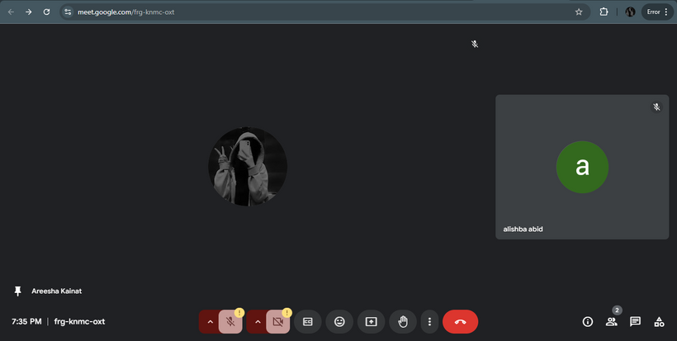
Collaboration
on Google Meet
Here’s a snapshot from my Google Meet session with my friend. We brainstormed ideas, discussed technical plans, and exchanged feedback to refine our project. Working together in real-time helped us solve challenges faster and share innovative ideas, making our project stronger.
Next Slide

Slide 18
Thank
You!
Only 5 days to go! The journey is getting exciting, and we're pushing forward with new ideas and solutions! Let’s keep the momentum going!

